Slide 1

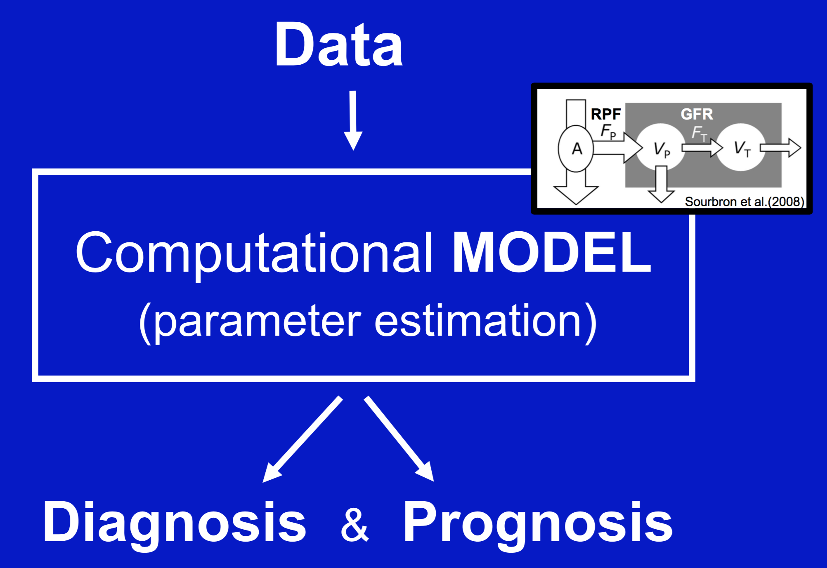
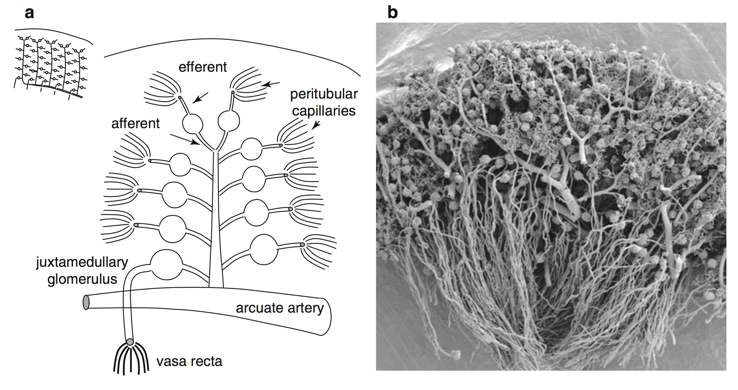
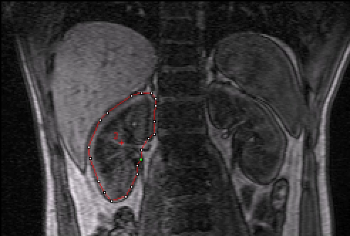

2nd International Scientific Symposium - Functional Renal Imaging: Where Physiology, Nephrology, Radiology and Physics Meet, Berlin Oct 12th 2017 09:00-09:20
What DCE MRI can(not) tell us about renal pathophysiology
http://www.cost.eu/COST_Actions/ca/CA16103
Syllabus: https://github.com/arvidl/dce-mri-renal-pathophysiology
Prof. Arvid Lundervold BSc, MD, PhD
Neuroinformatics and Image Analysis Laboratory, Neural Networks Research Group
Department of Biomedicine
University of Bergen
Norway
Lerman LO, Textor SC (eds). Renal Vascular Disease, Springer 2014

Slide 2
Renal pathophysiology and DCE-MRI
Kidney structure and function
Kidney diseases & Bayes theorem
Renal pathophysiology – multiscale approach – systems medicine
What renal DCE-MRI
can tell us
can not tell us
Software for DCE-MRI - estimation of renal perfusion and filtration
(“open science” & “reproducible research”)
Other measurement techniques
What DCE MRI can(not) tell us about renal pathophysiology (Lundervold, Thu 12 Oct 09:00)
What ASL MRI can(not) tell us about renal pathophysiology (Buchanan, 09:40)
What oxygen sensitive MRI can(not) tell us about renal pathophysiology (Prasad, 14:10)
What diffusion MRI can(not) tell us about renal pathophysiology (Vallee, 16:50)

Slide 3
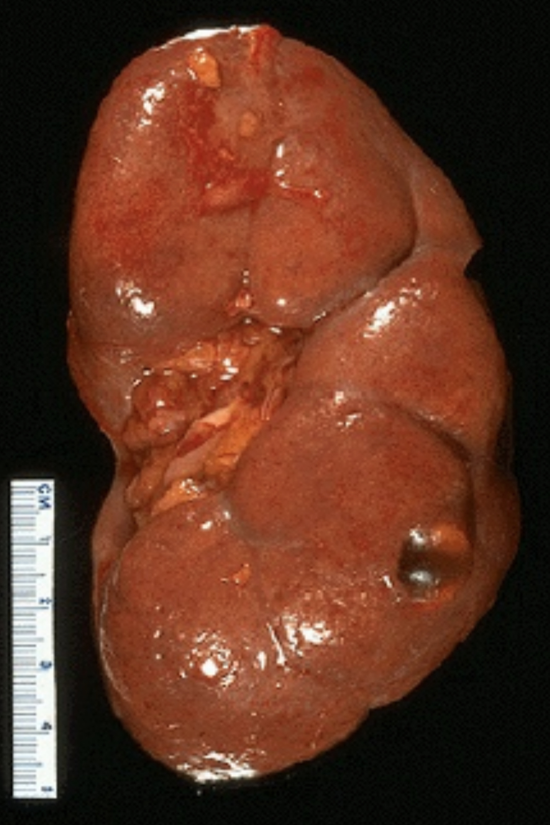
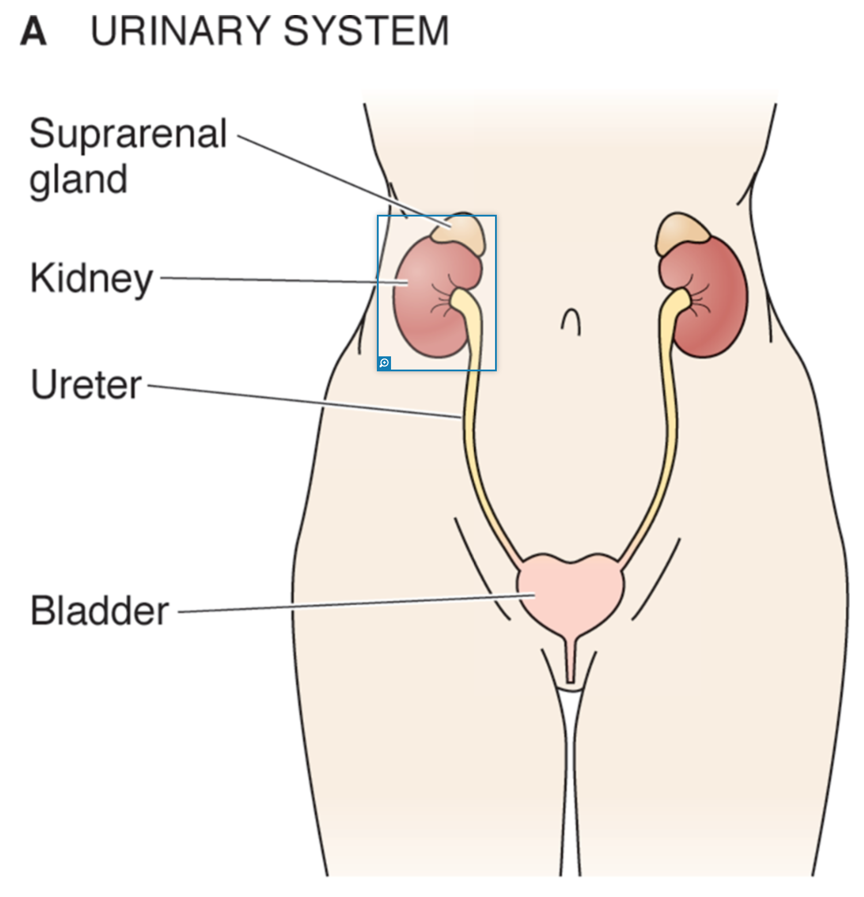

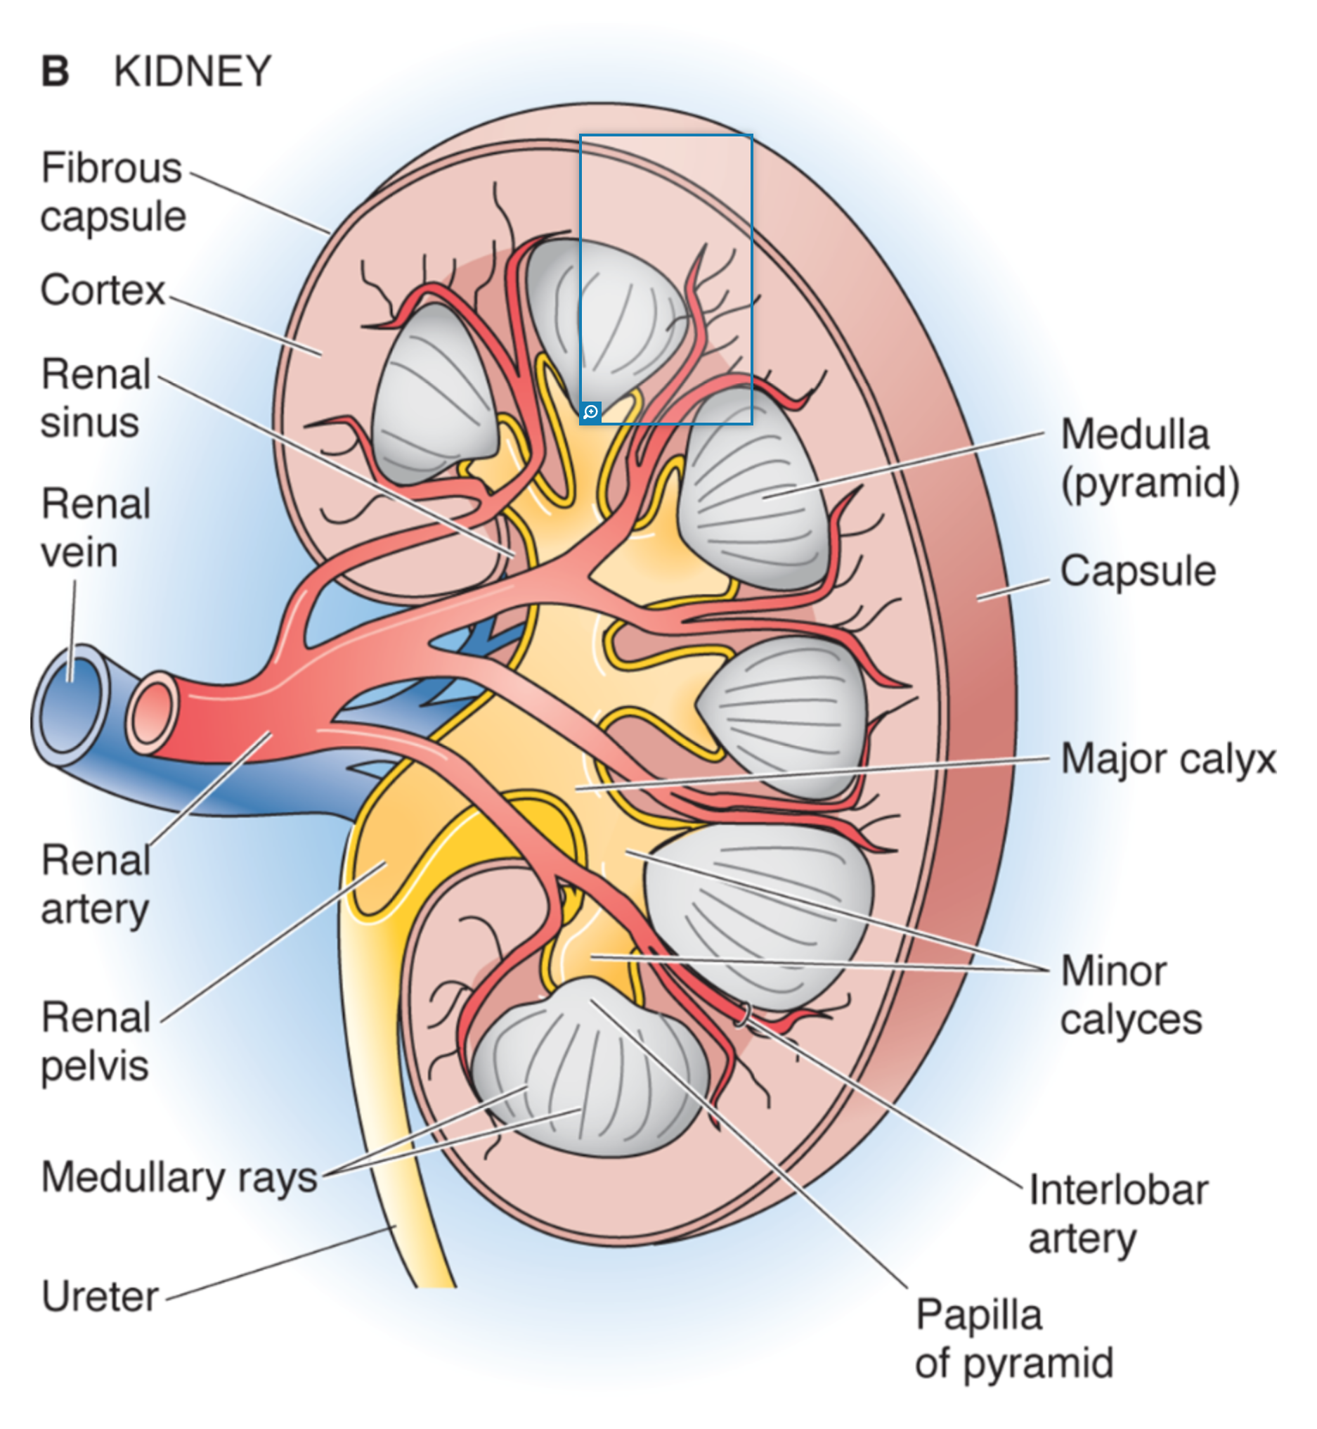
Kidney morphology
Cortex
Medulla
(pyramid)
act as filters
body homeostatsis
(fluid status, pH, electrolytes)
hormon production
<0.5% of body weight
~20% of cardiac output
Renal
pelvis
Boron & Boulpaep, Medical Physiology, 3rd ed. Elsevier, 2017

Slide 4
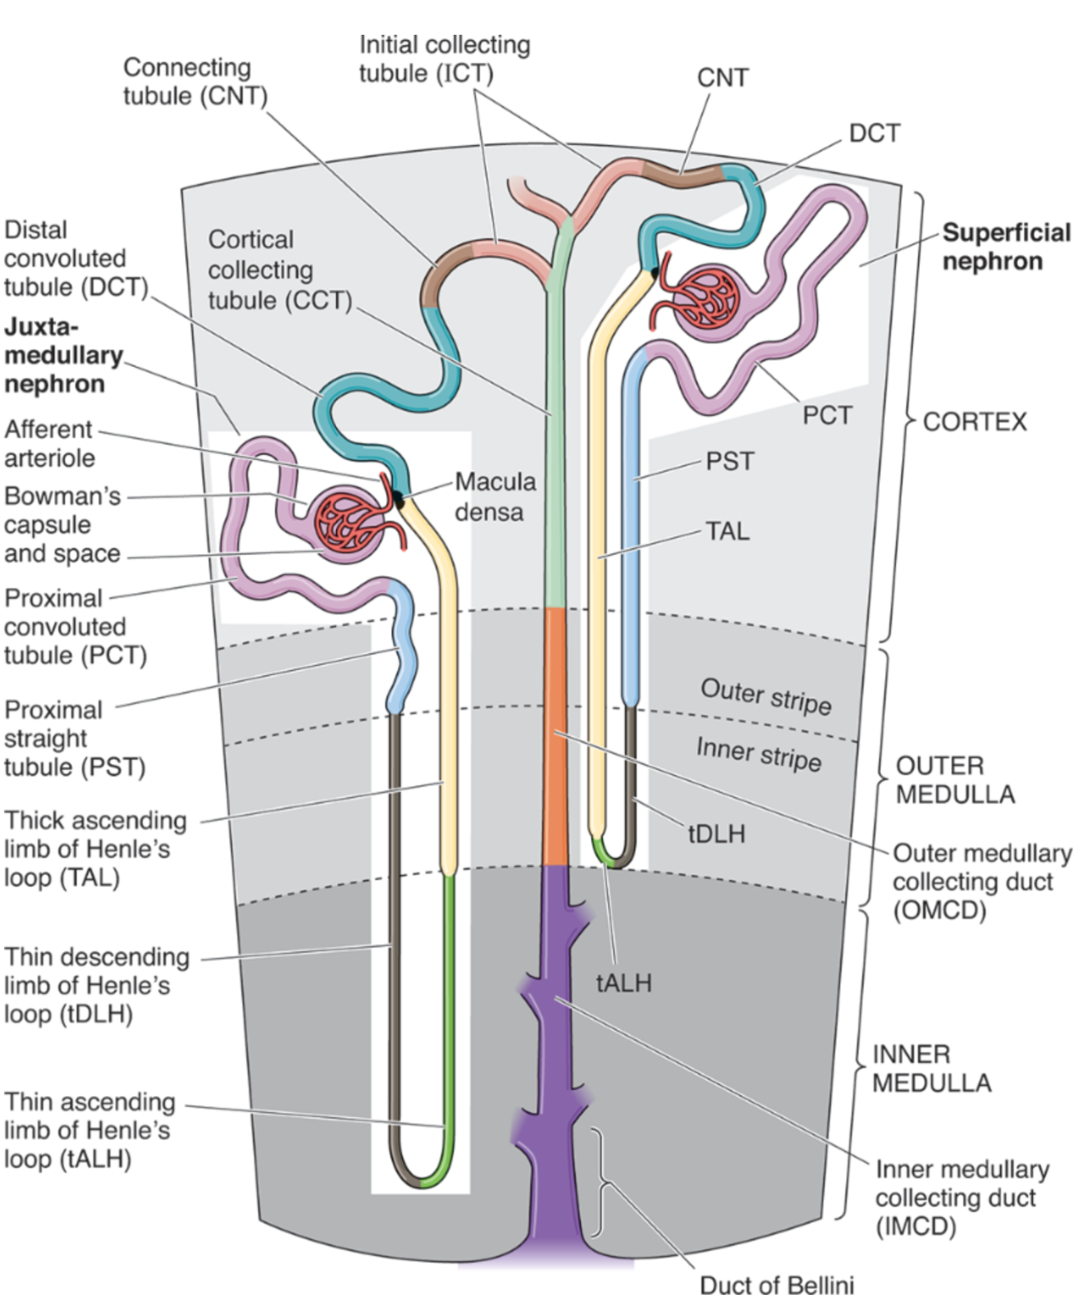
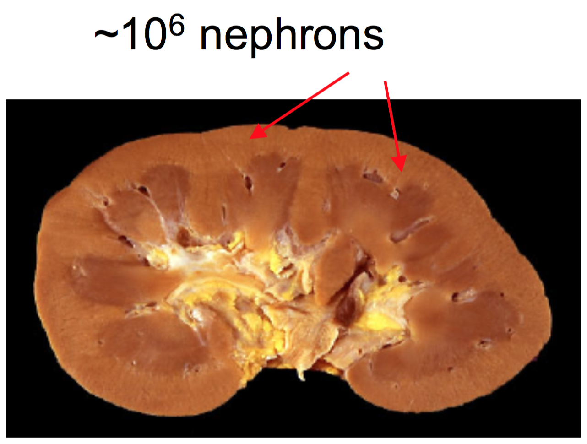
The nephron
Superficial
nephron
Juxtamedullary
nephron
CORTEX
OUTER
MEDULLA
INNER
MEDULLA
Boron & Boulpaep, Medical Physiology, 3rd ed. Elsevier, 2017

Slide 5
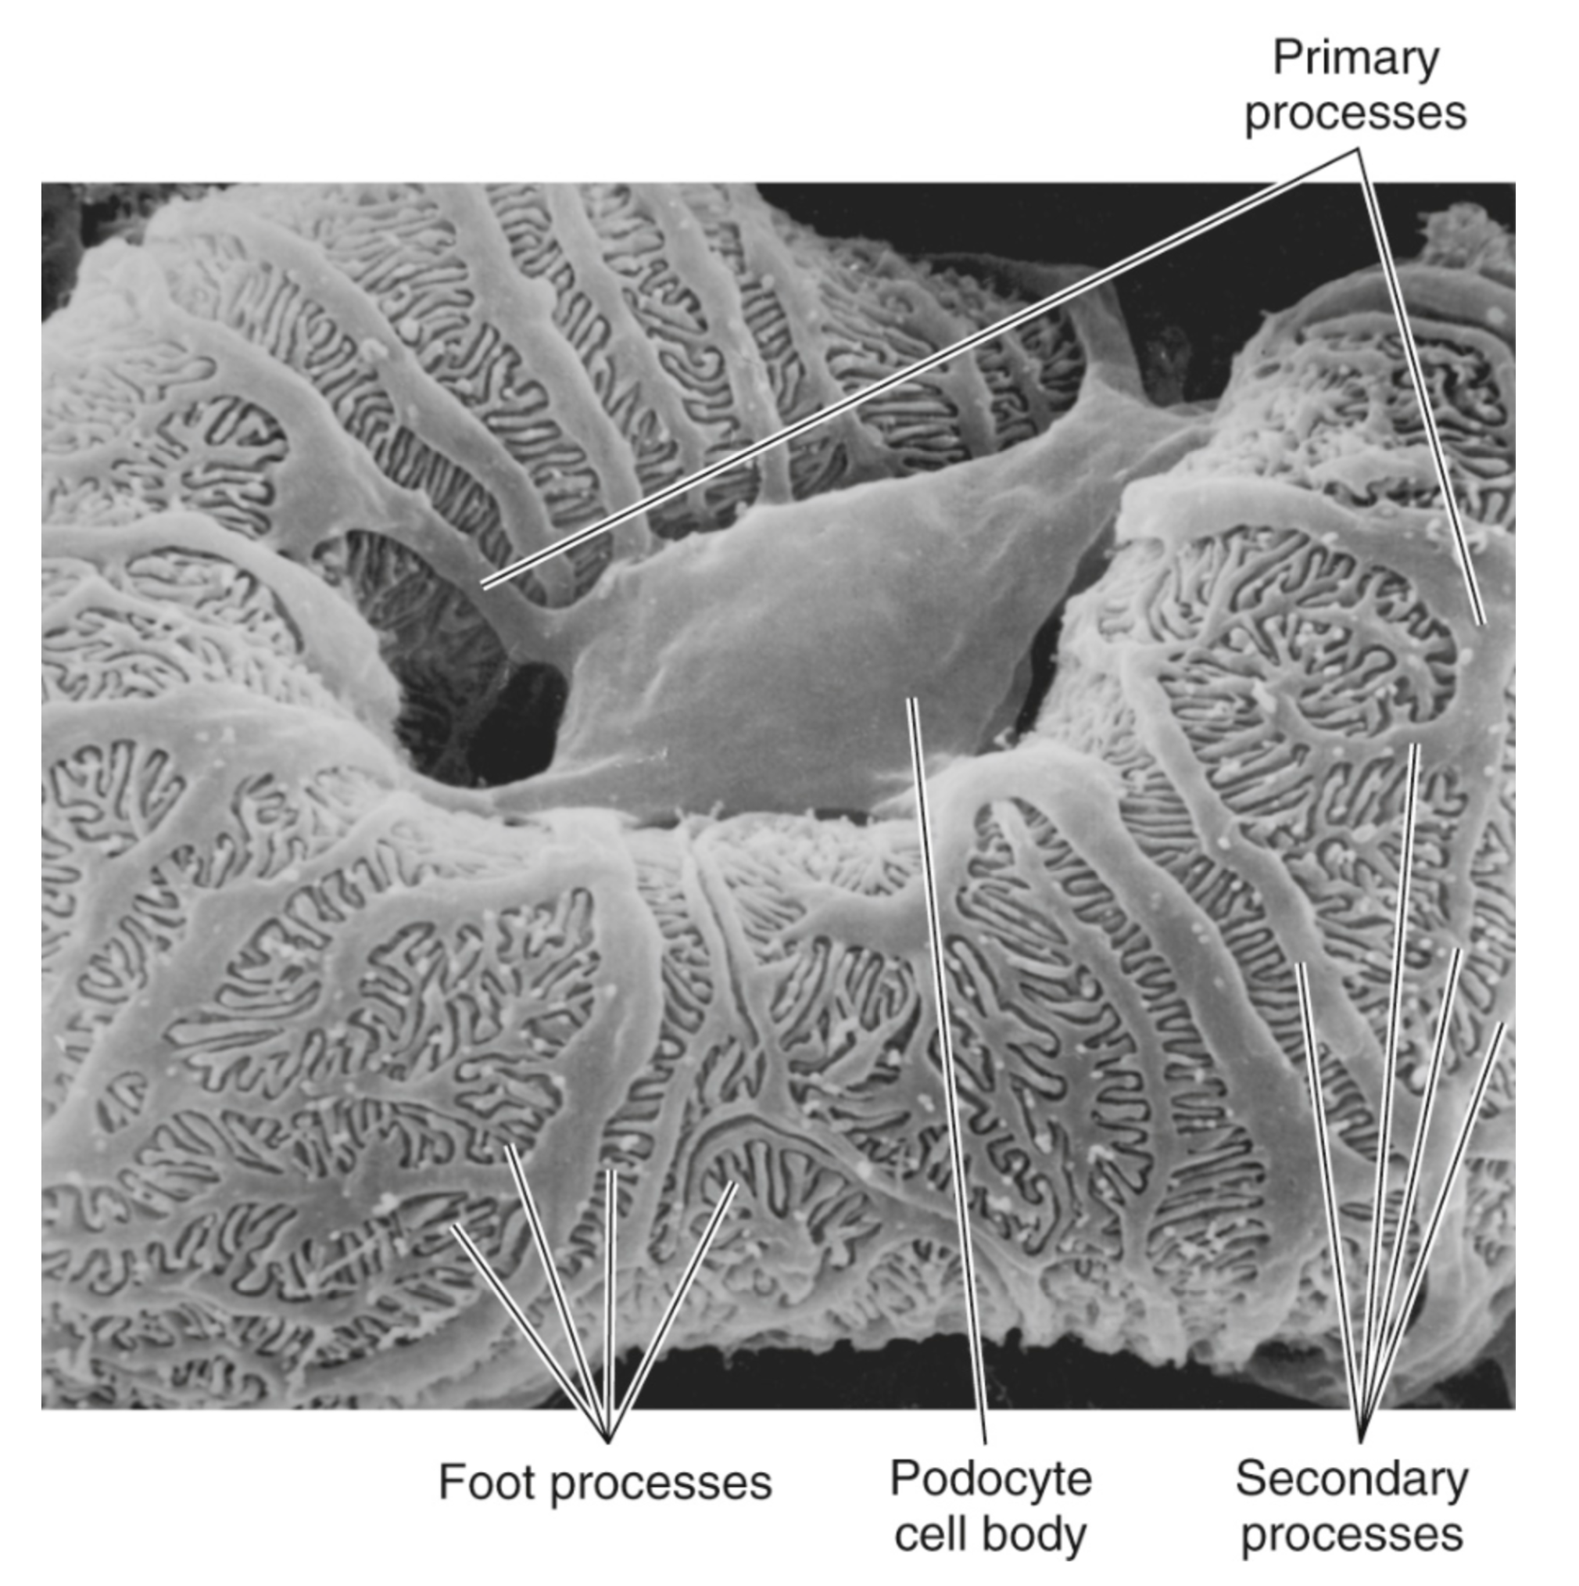
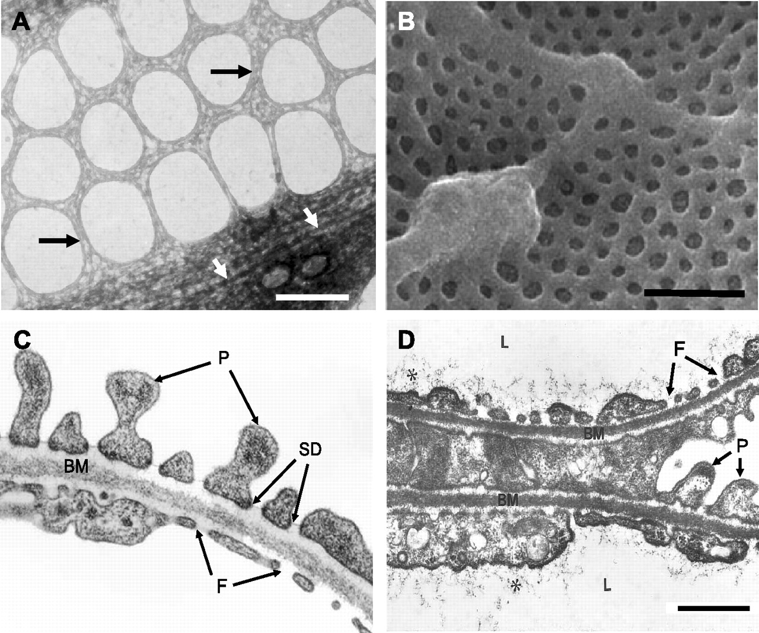
measureable by DCE-MRI
Where the filtration (GFR) takes place
Primary
processes
Primary
processes
Glomerular
capillary
covered by the
foot processes
of podocytes
Bowman’s
space
Capillary
lumen
TEM x 48000 1 μm
Foot processes
Podocyte
Cell body
Secondary
processes
Satchell & Braet Am J of Physiol Renal Physiology 2009:296(5):F947-F956.
Boron & Boulpaep, Medical Physiology, 3rd ed. Elsevier, 2017

Slide 6
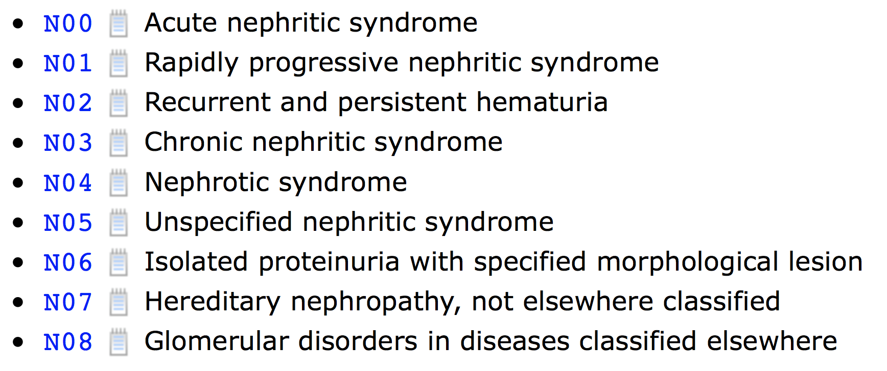
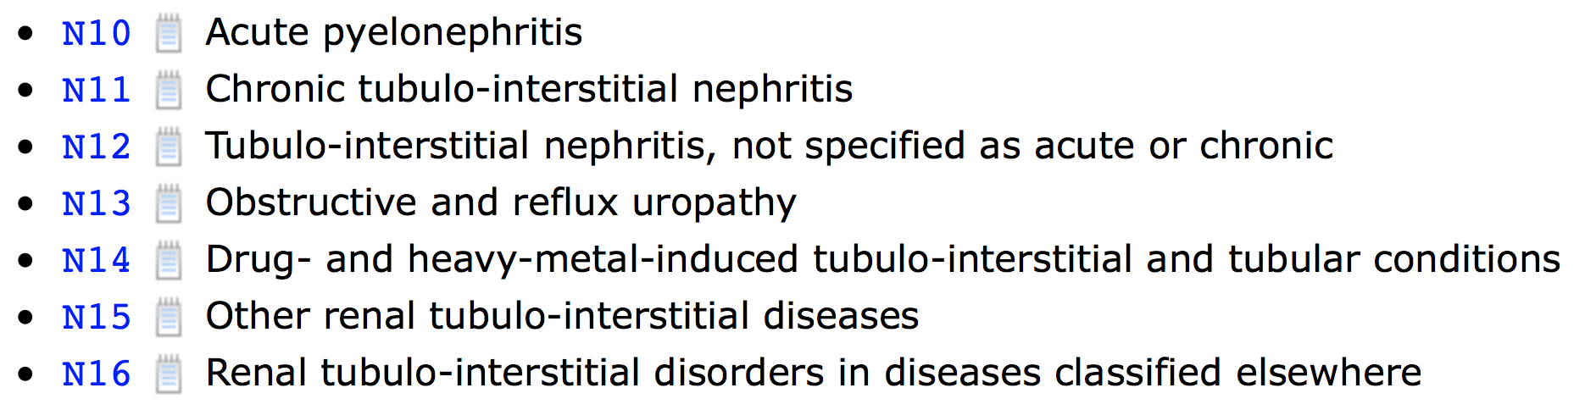

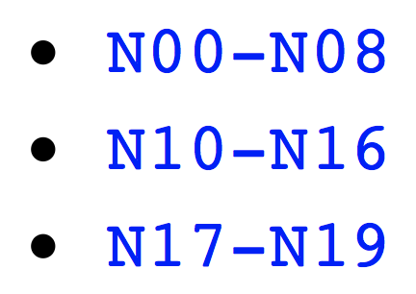
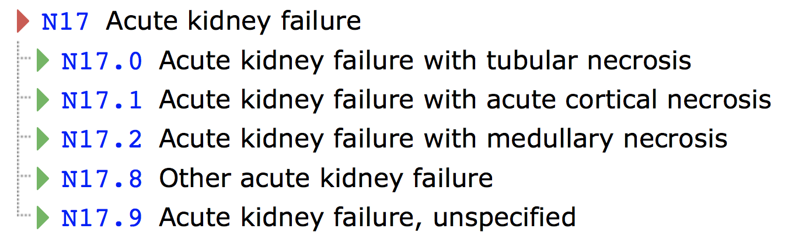
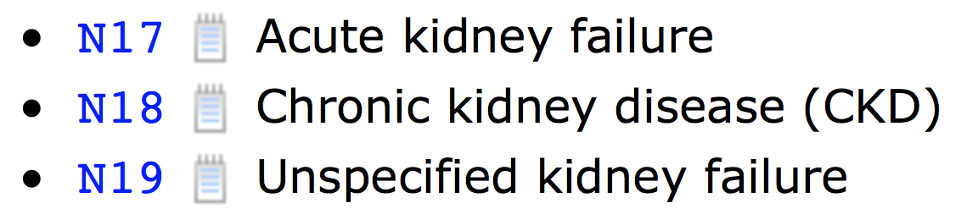
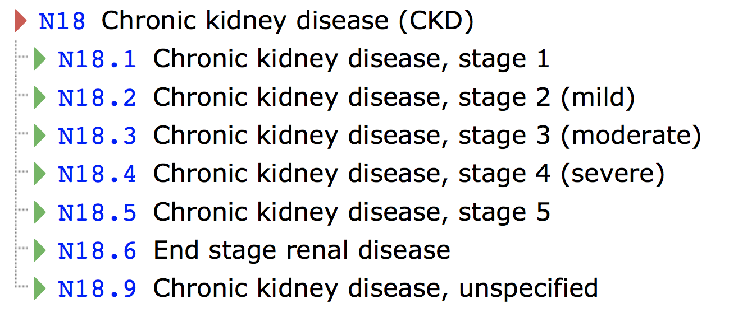
Pathophysiology
observed condition
during a disease state
operating
mechanism
Diseases of the
genitourinary
system N00-N99
Glomerular diseases
Renal tubulo-interstitial diseases
Acute kidney failure and
chronic kidney disease

Slide 7
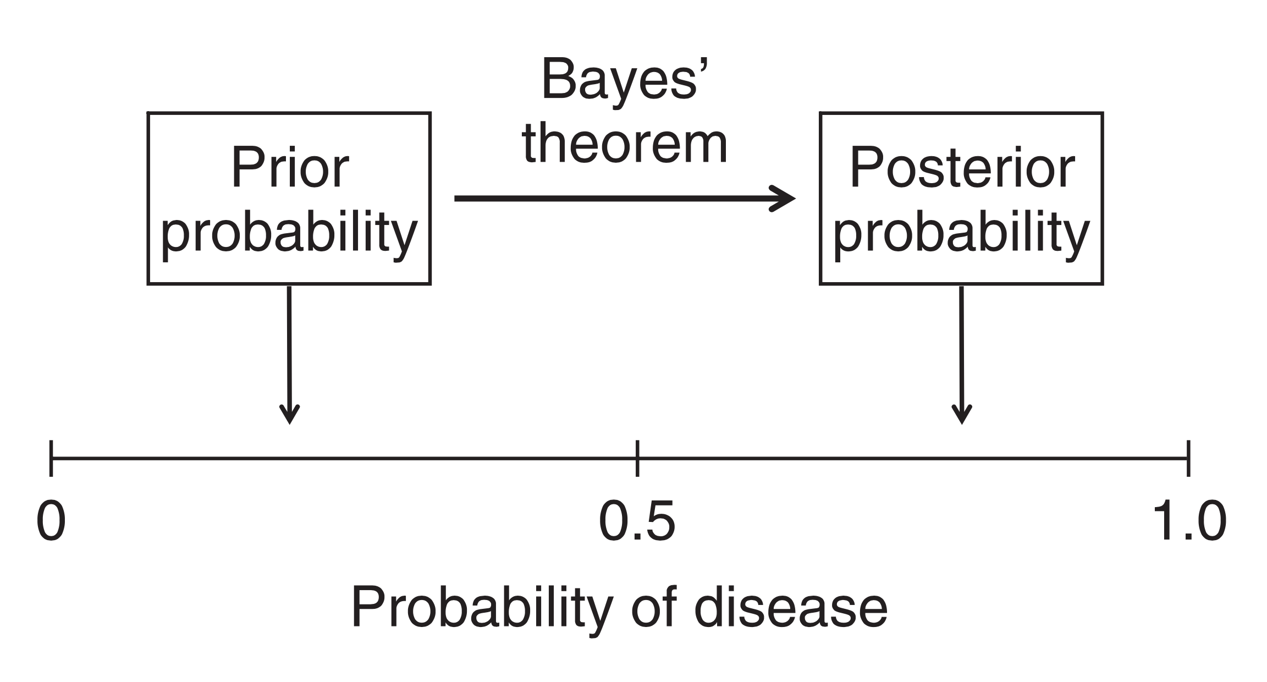
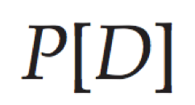
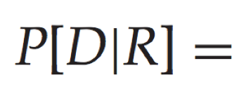
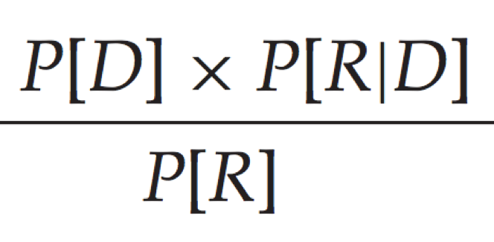
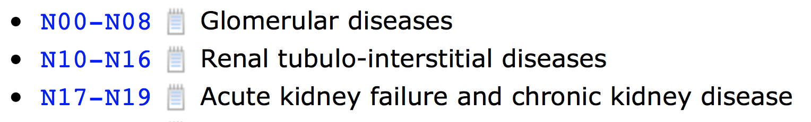

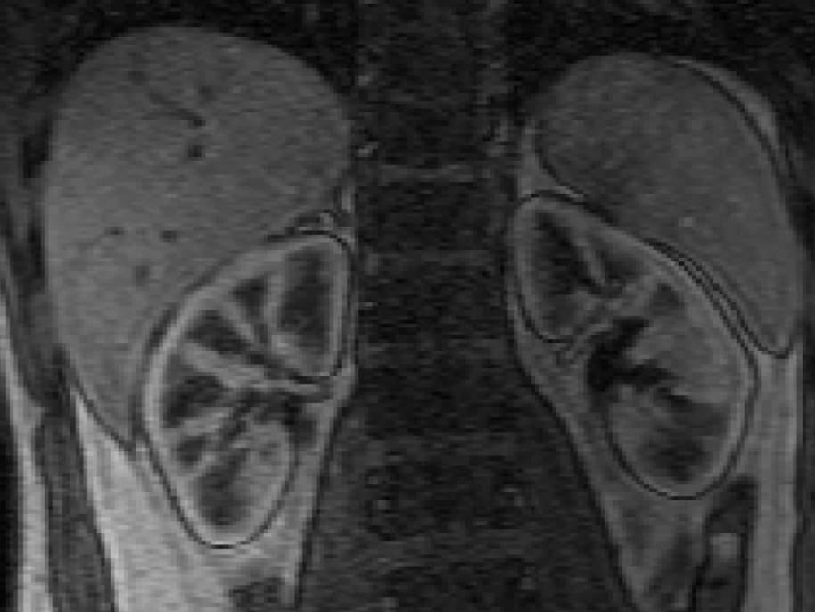
The pre-test probability and the post-test probability of disease
Pathophysiology
and
Diseases of the
genitourinary
system N00-N99
D = disease
R = test result
The importance of imaging results
Sox et al. Medical Decision Making 2nd ed., 2013

Slide 8
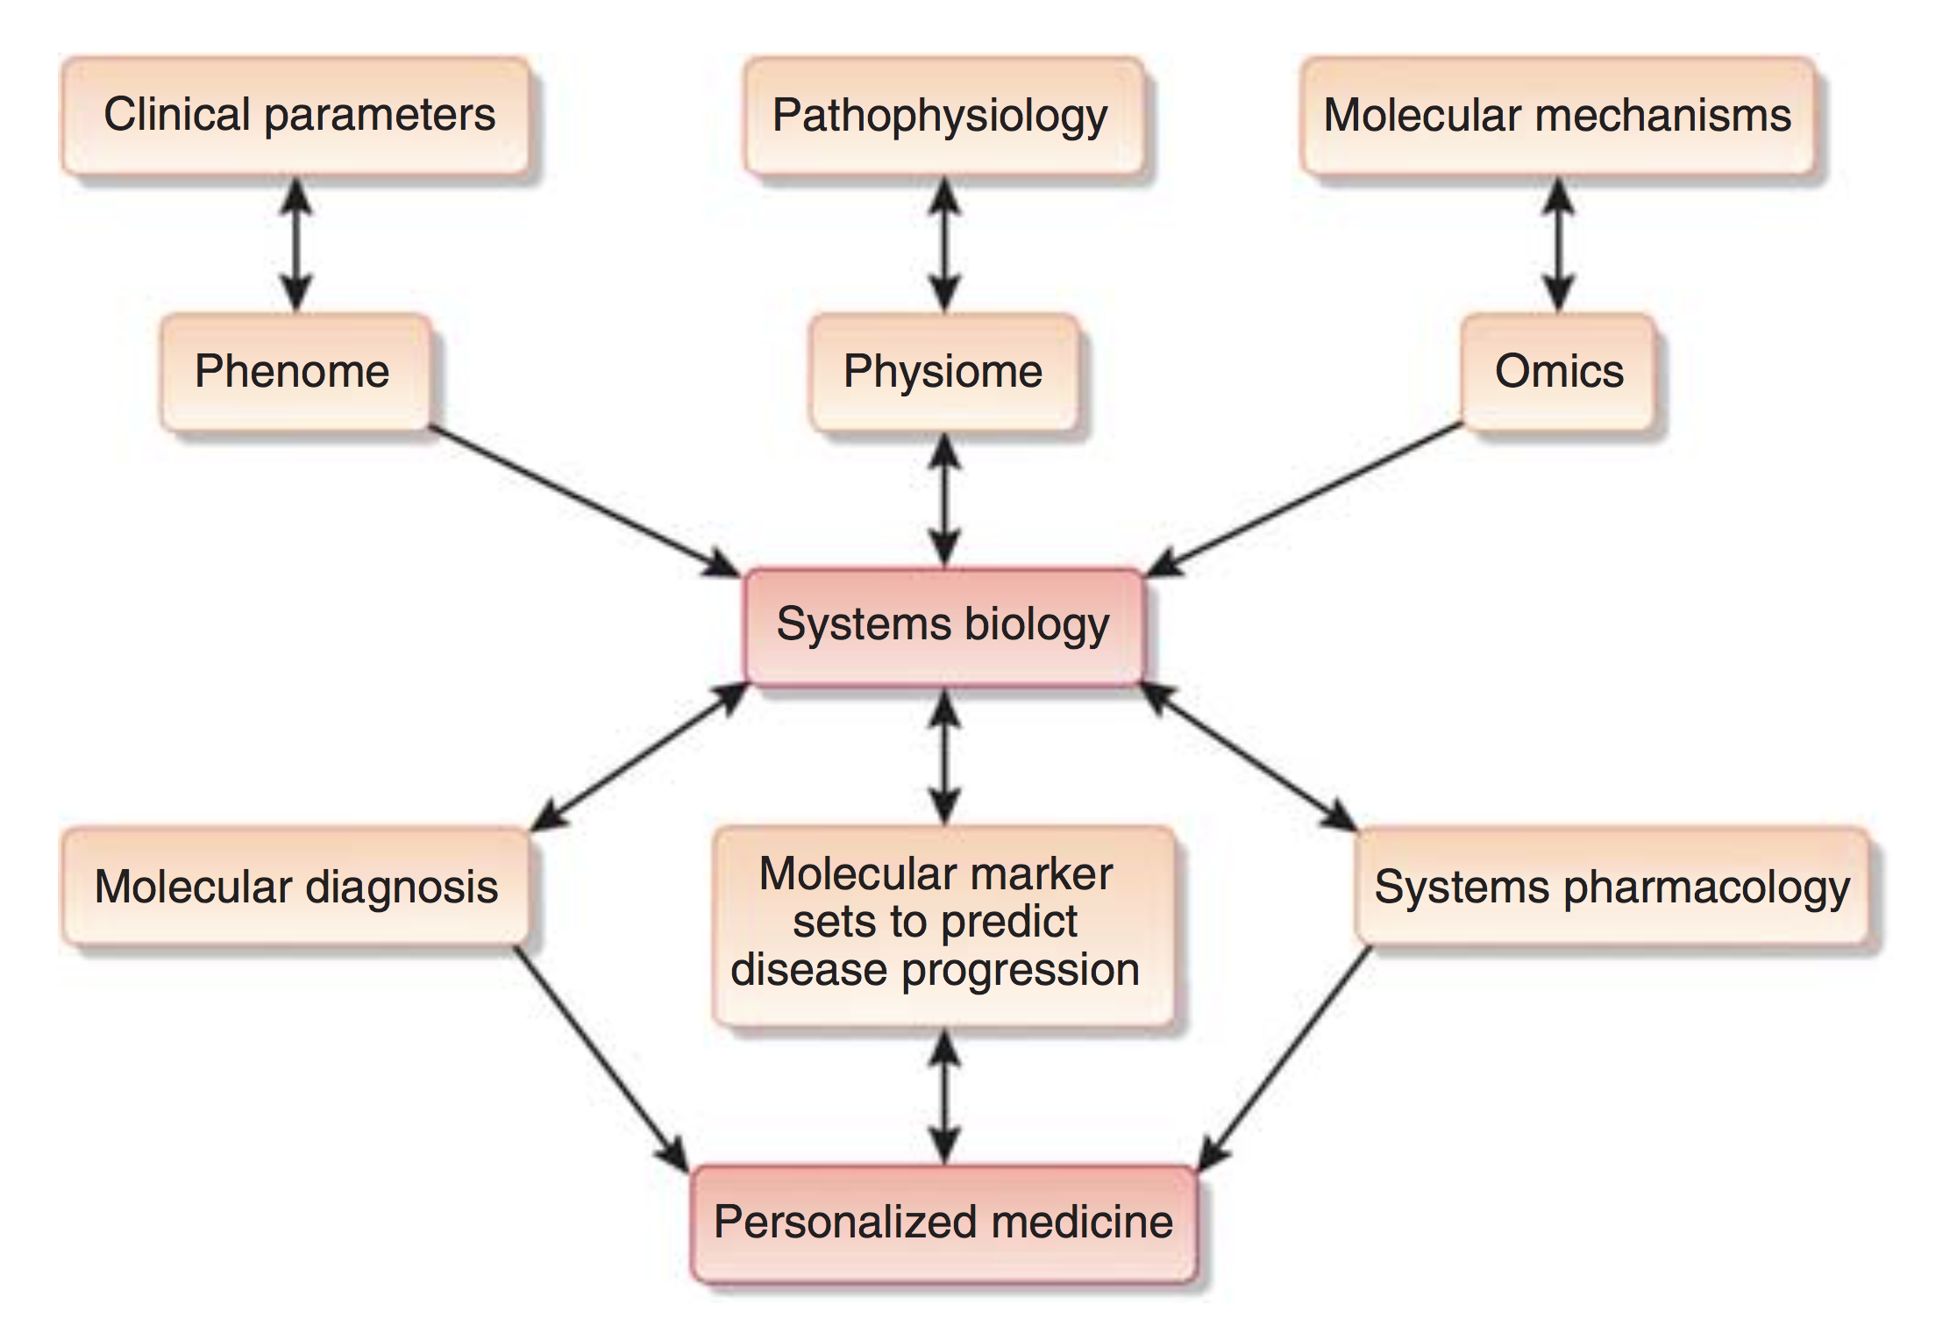

Systems biomedicine of kidney diseases
Integrate
clinical
parameters
Assess
disease
pathophysiology
Reveal molecular mechanisms of diseases
More accurate molecular diagnosis
Predict disease prognosis
Targeted therapeutic agents
s
y
s
t
e
m
s
l
e
v
e
l
enable
Imaging &
He et al. Systems biology of kidney diseases Kidney International 2012;81:22–39

Slide 9
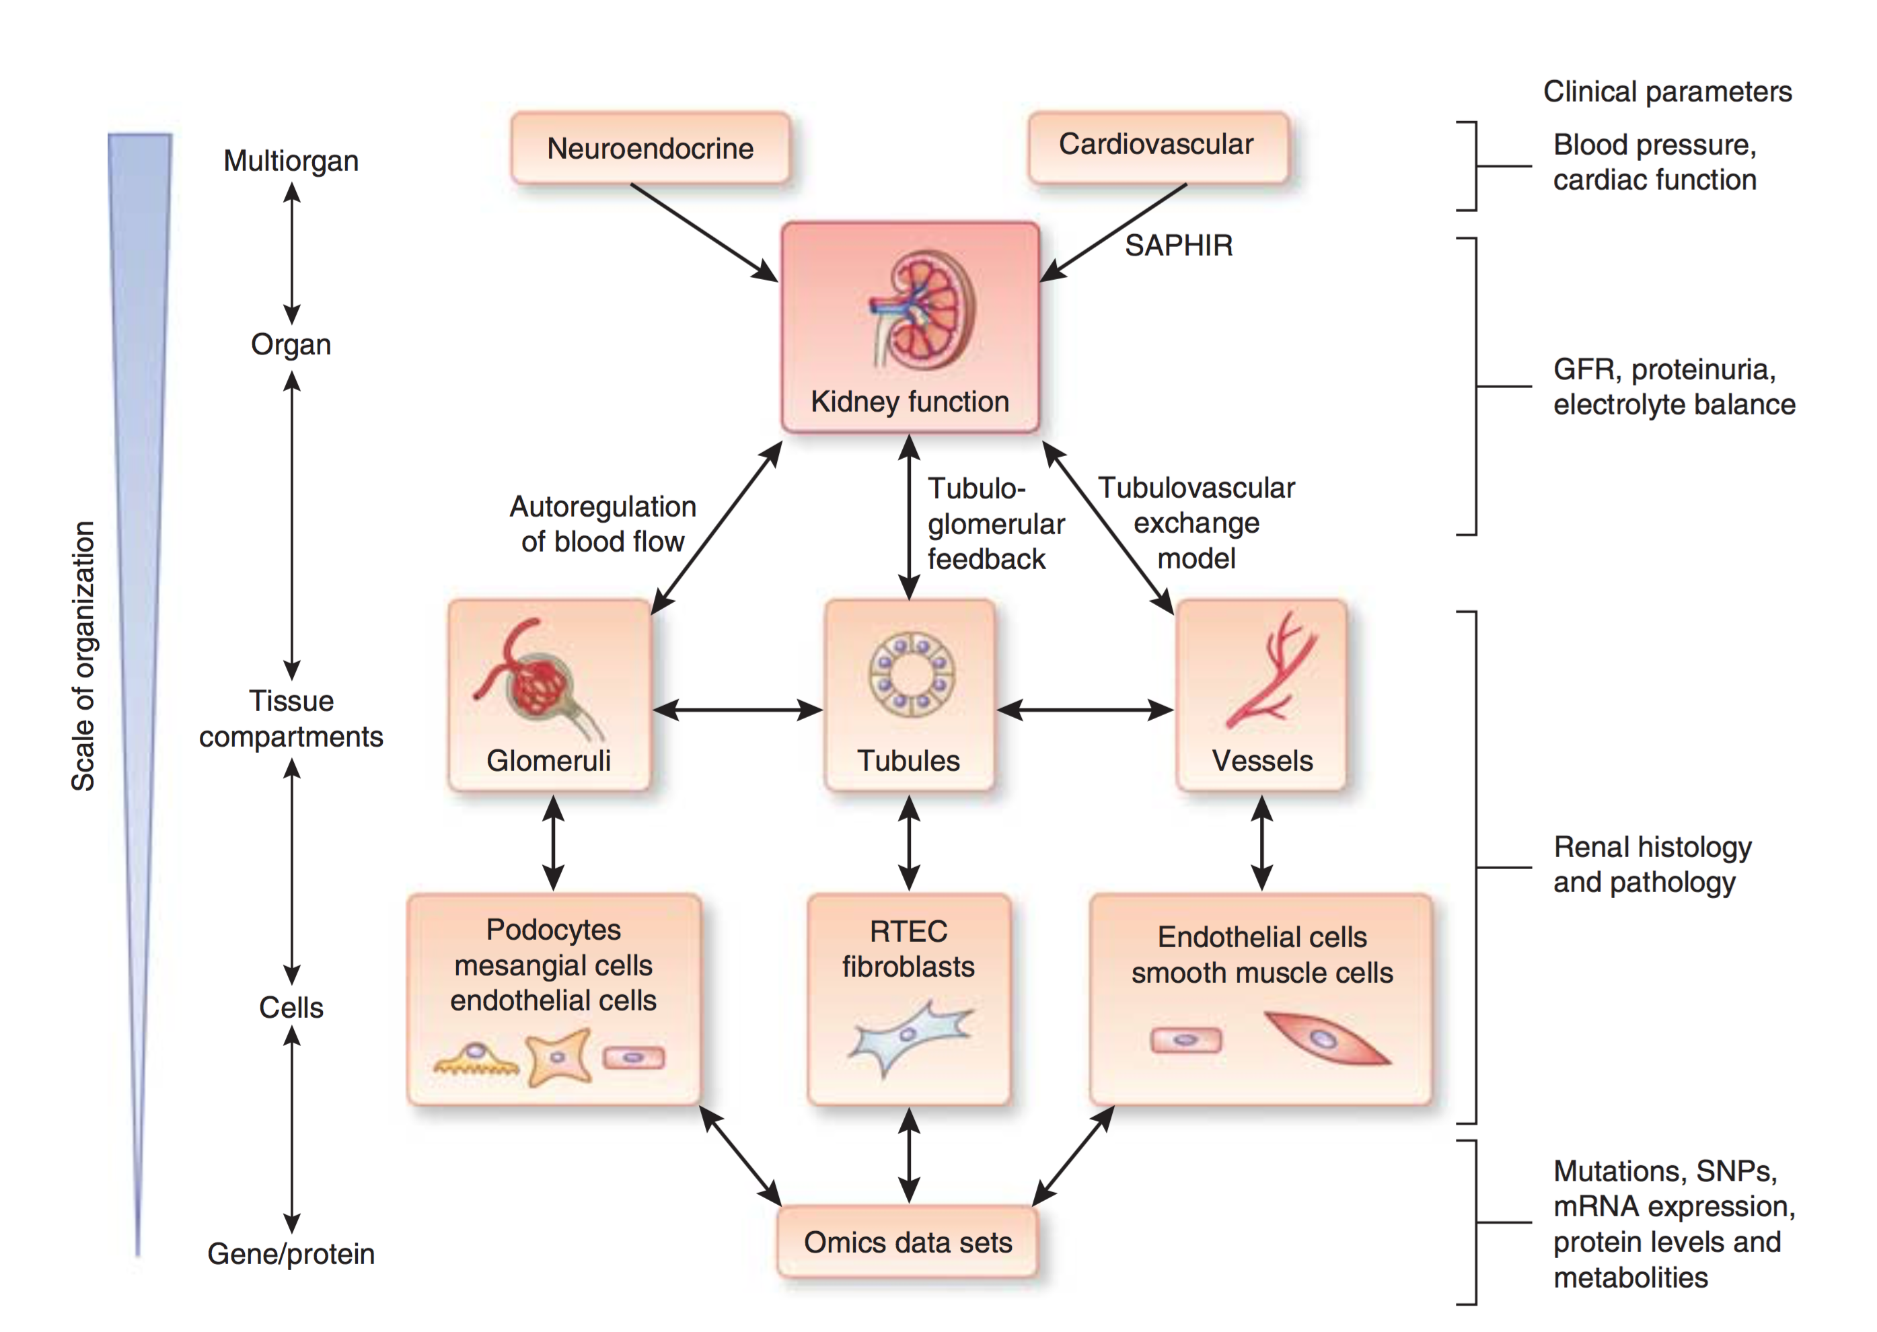
Multiscale analysis of kidney function
Normal kidney function
e.g. maintenance of
fluids, electrolytes,
and acid–base balance
and clearance of toxins
maintained by
coordinated
regulation
at different
levels
of organization
a Systems Approach for
PHysiological Integration of Renal,
cardiac and respiratory function
“ Radiomics “
He et al. Systems biology of kidney diseases Kidney International 2012;81:22–39

Slide 10
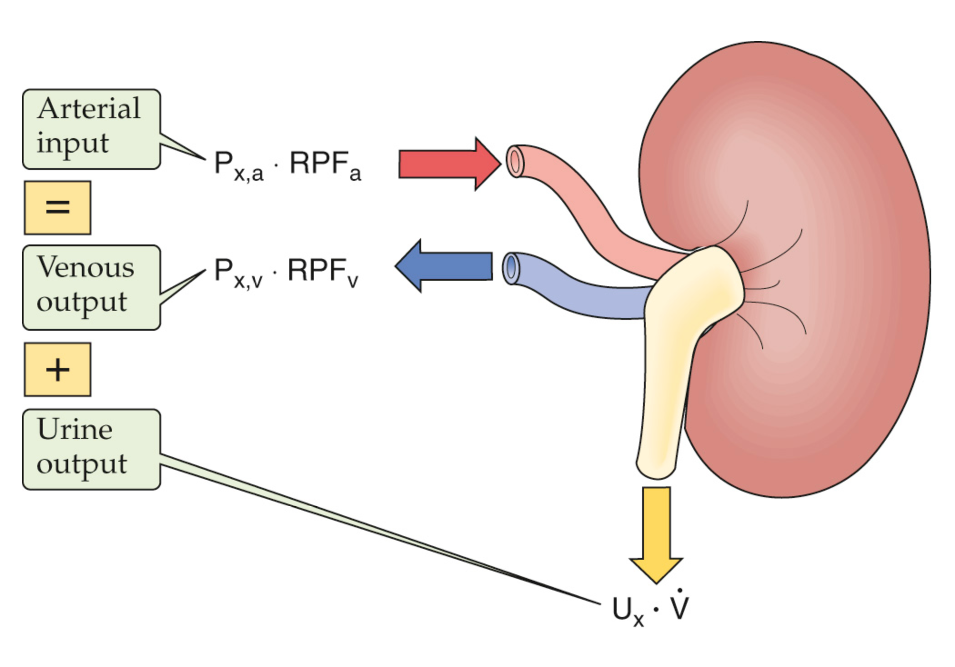
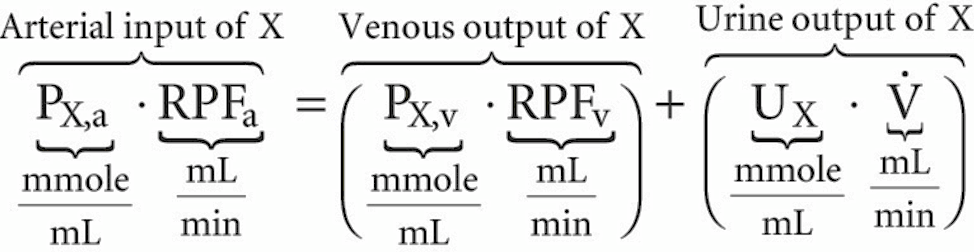
DCE-MRI
basic principle
“ Mass balance “ of a solute or tracer X
( X is not synthesized, degraded, or accumulated in the kidney )
P_{X,a}
plasma concentration of X in renal artery
P_{X,v}
plasma concentration of X in renal vein
RPF_{a}
renal plasma flow in renal artery
RPF_{v}
renal plasma flow in renal vein
U_{X}
concentration of X in urine
.
Arterial input of X
Venous output of X
Urine output of X
V
urine flow (volume urine per time unit)
Boron & Boulpaep, Medical Physiology, 3rd ed. Elsevier, 2017

Slide 11
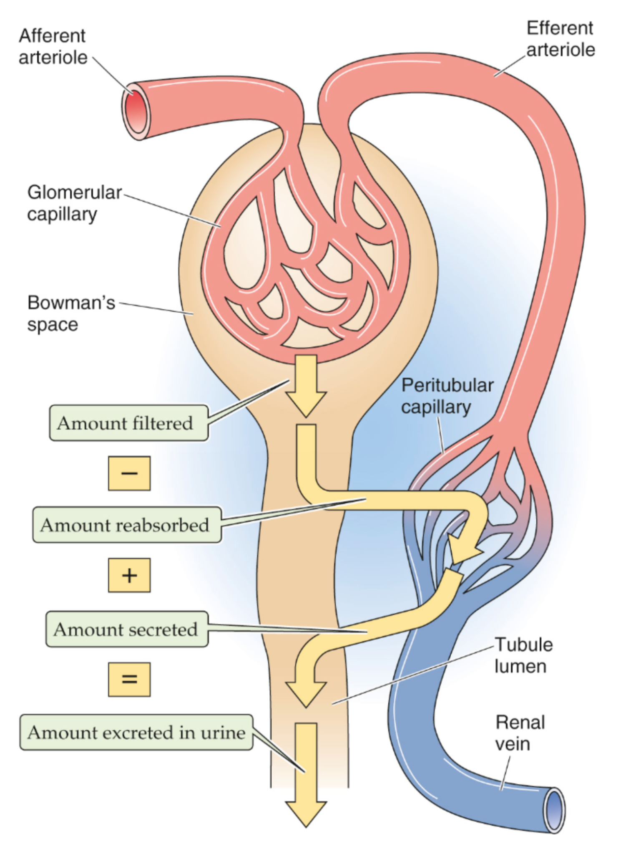
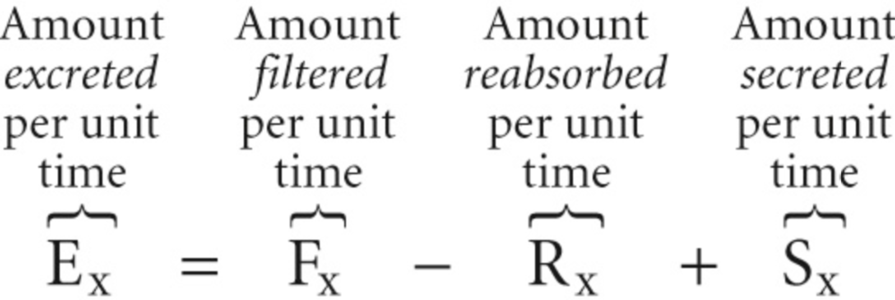
Afferent
arteriole
Boron & Boulpaep, Medical Physiology, 3rd ed. Elsevier, 2017
Efferent
arteriole
“ Mass balance “
clearance of a substance X
RPF_{a}
Glomerular
capillary
Amount
excreted
per unit
time
Amount
filtered
per unit
time
Amount
reabsorbed
per unit
time
Amount
secreted
per unit
time
Bowman’s
space
GFR
F_{X}
R_{X}
S_{X}
Tubule
lumen
Renal
vein
E_{X}

Slide 12
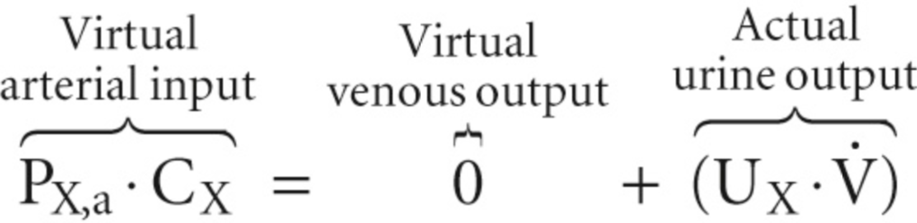
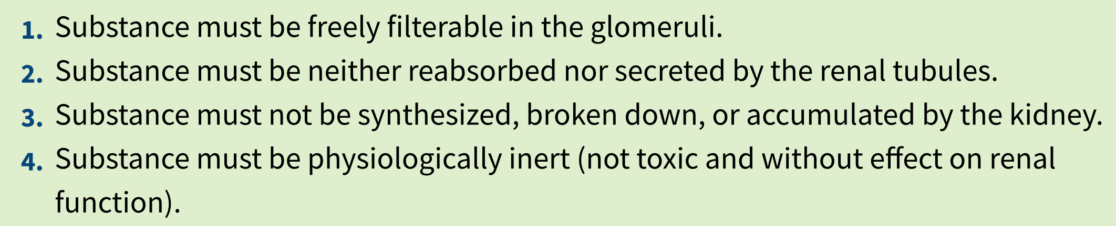
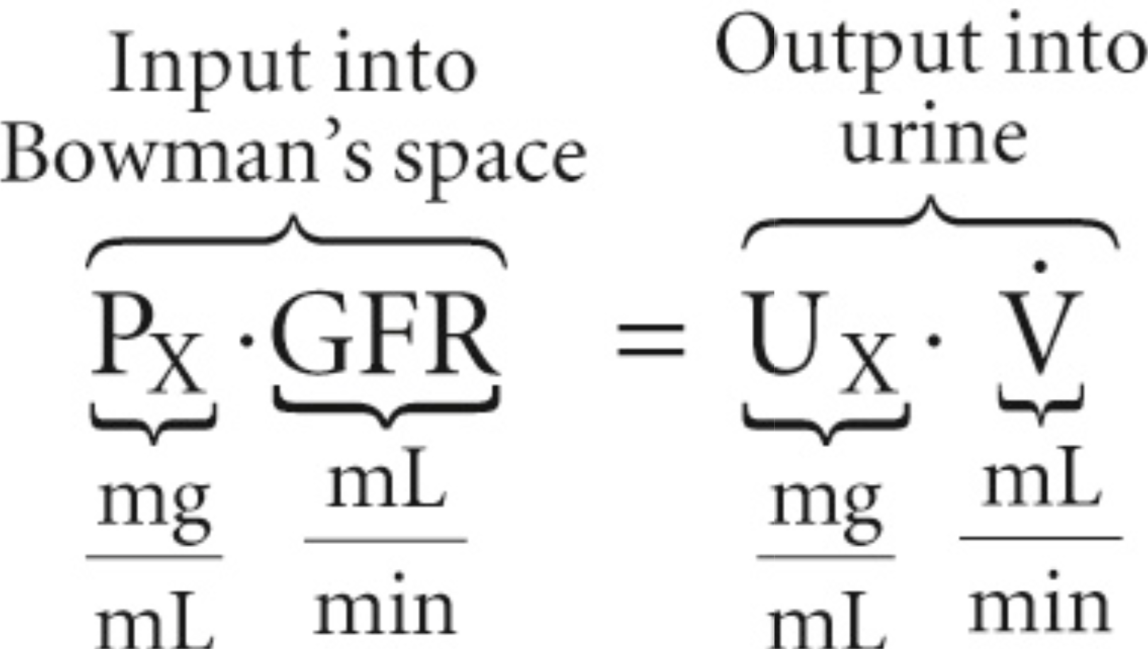
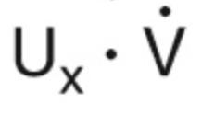
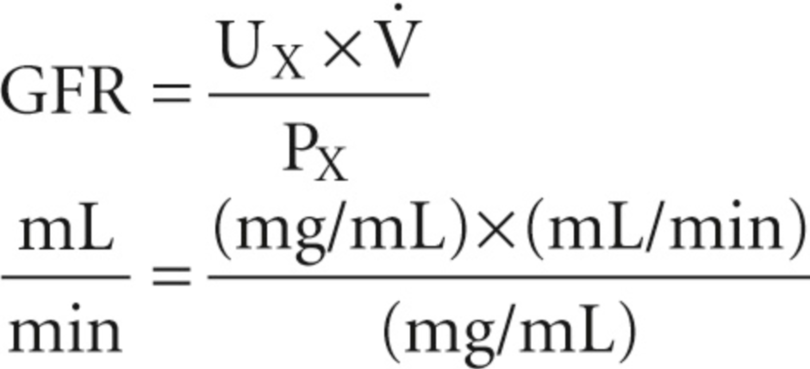
Afferent
arteriole
Boron & Boulpaep, Medical Physiology, 3rd ed. Elsevier, 2017
Efferent
arteriole
“ Mass balance “
clearance of a substance X
P_{X,a}
Glomerular
capillary
Bowman’s
space
GFR
Clearance of X, C_{X}
GFR
Tubule
lumen
Renal
vein
Input into
Bowman’s space
Output into
urine
P_{X,v} = 0

Slide 13
Afferent
arteriole
Boron & Boulpaep, Medical Physiology, 3rd ed. Elsevier, 2017
Efferent
arteriole
“ Mass balance “
clearance of a substance X
RPF_{a}
Glomerular
capillary
Bowman’s
space
GFR
F_{X}
Clearance of X, C_{X}
R_{X}
S_{X}
GFR
Tubule
lumen
Renal
vein
Input into
Bowman’s space
Output into
urine
E_{X}
C_{inulin} = GFR
~ 125 mL/min
C_{glucose} = 0
C_{PAH} = RPF_{a}
~ 600 mL/min
Filtration fraction, FF = GFR / RPF
~ 0.2

Slide 14
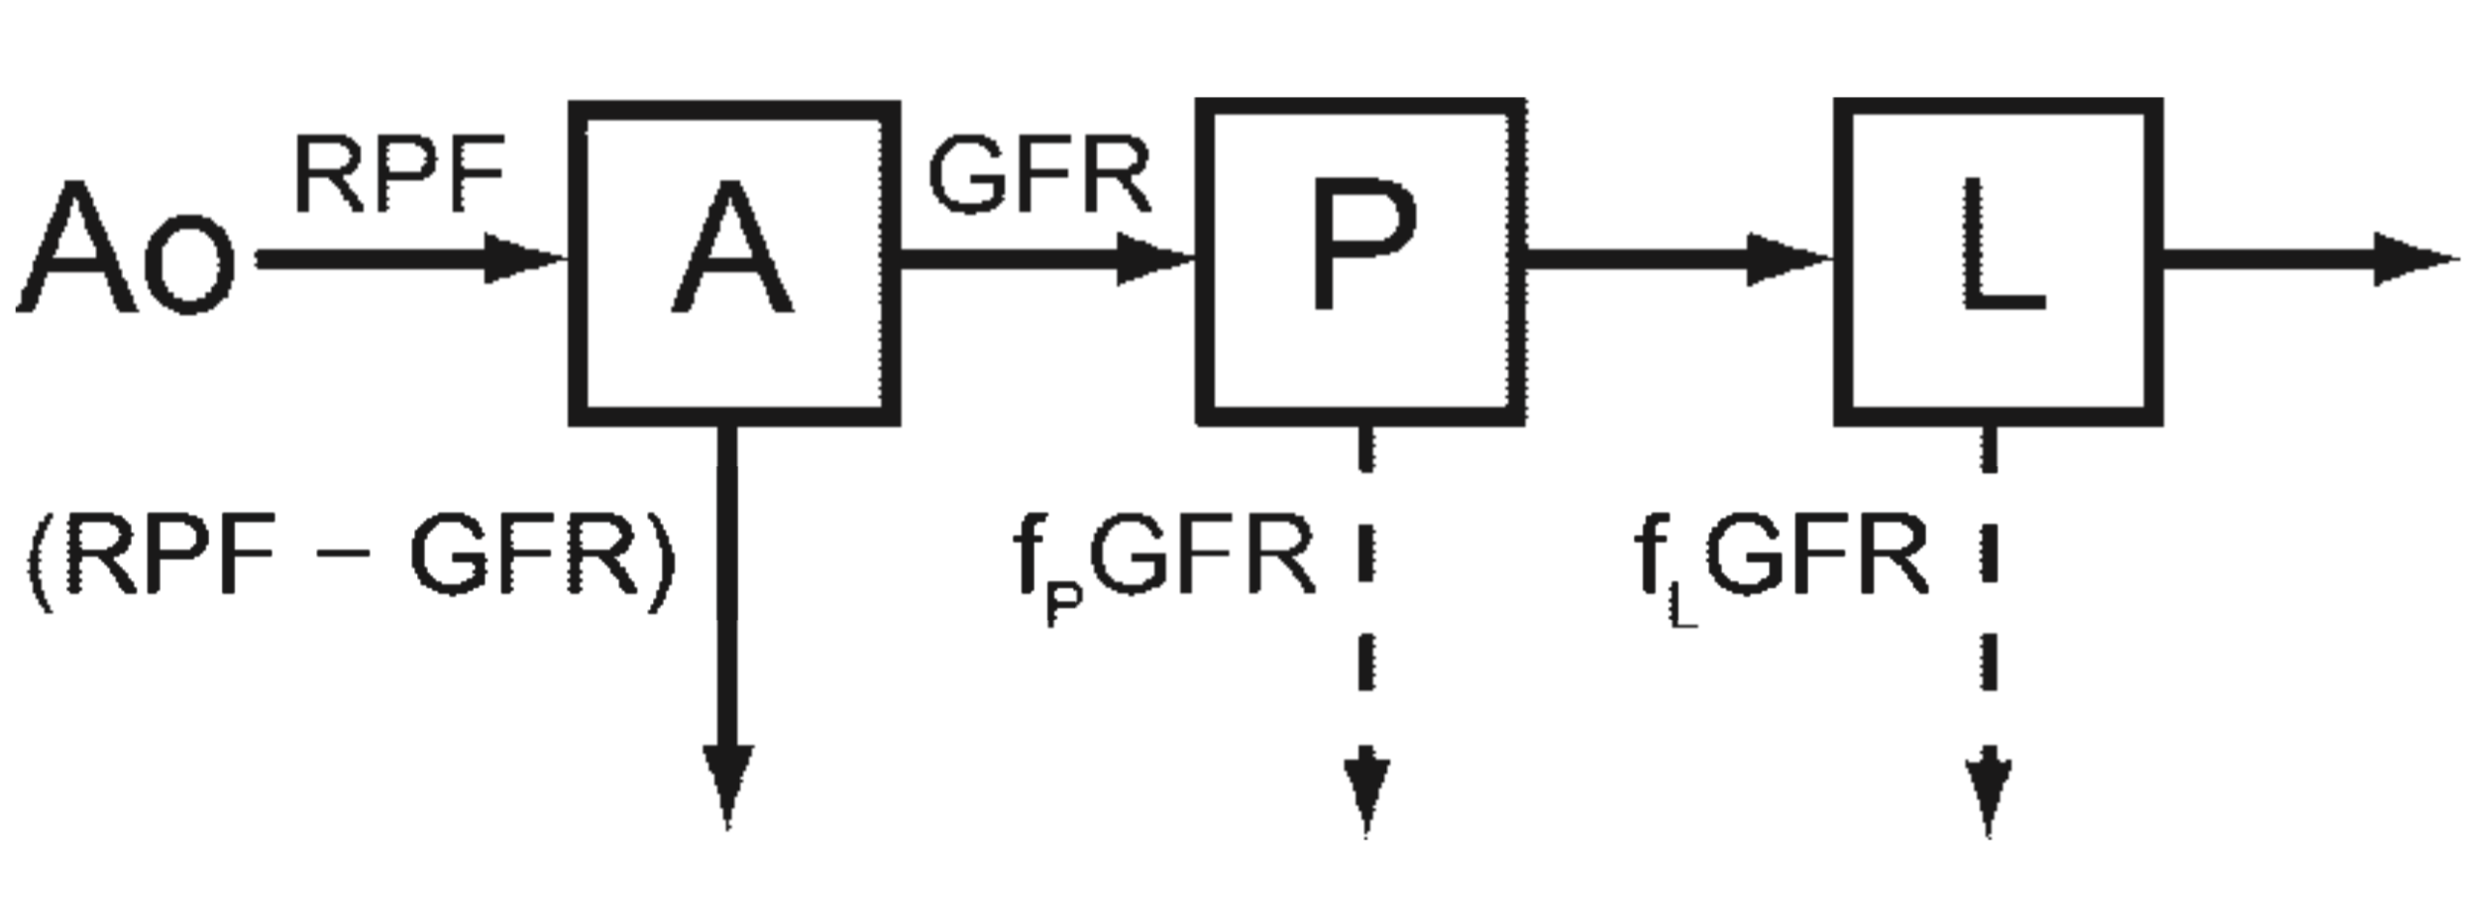
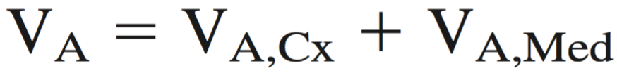
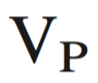
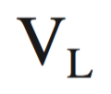
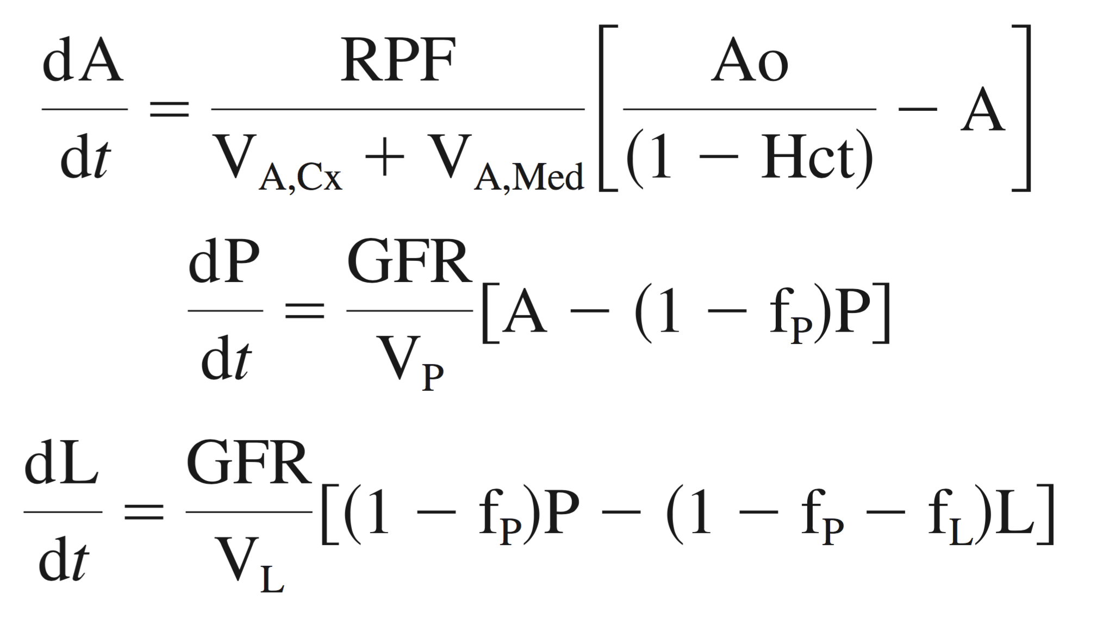
Three-compartment modeling of renal perfusion and filtration
Simplified three-compartment model for
determination of single-kidney GFR:
Conservation of mass (simplified model):
X = tracer substance (e.g. Gd)
(1 – f_{P}) GFR
(1 – f_{P} - f_{L}) GFR
cortex medulla
[mL]
Dashed lines represent tracer-free fluid resorption, in terms of fractions of GFR: f_{P}, f_{L}.
- volume of P [mL]
- volume of L [mL]
Ao (t) - aorta (AIF) [mM X/ mL whole blood]
A (t) - intrarenal arteries and glomerular vessels
[mM X / mL plasma]
P (t) - proximal convoluted tubule [mM X / mL tubular fluid]
L (t) - loop of Henle [mM X / mL tubular fluid]
RPF = Renal plasma flow [mL/min]
GFR = Glomerular filtration rate [mL/min]
Hct = hematocrit, (1 – Hct) = plasma fraction
System of 3 coupled ordinary differential equations, ODEs
Lee VS et al. Renal function measurements from MR renography and a simplified multicompartmental model. Am J Physiol Renal Physiol 2007;292:F1548–F1559.

Slide 15
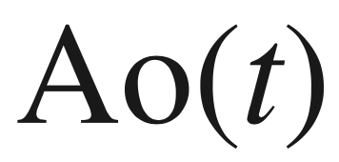
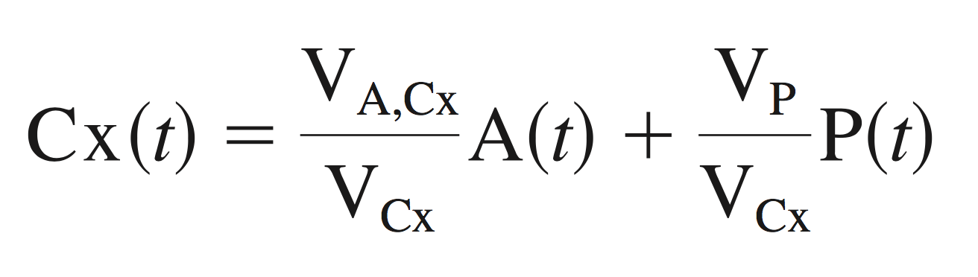
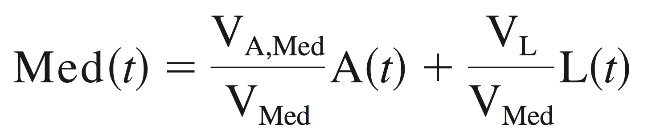
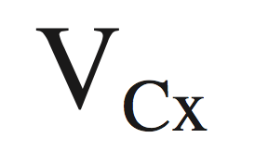
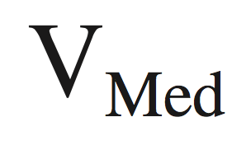
Three-compartment modeling of renal perfusion and filtration
Simplified three-compartment model for
determination of single-kidney GFR:
Conservation of mass
(1 – f_{P}) GFR
(1 – f_{P} - f_{L}) GFR
Parameters estimated:
MR measurements:
(with some simplifying assumptions)
RPF
The AIF, from MR renography (DCE-MRI)
GFR
from MR renography
f_{P}
f_{L}
MR renography
V_{A,Cx}
The volumes and from segmented 3D MRI
V_{A,Med}
Lee VS et al. Renal function measurements from MR renography and a simplified multicompartmental model. Am J Physiol Renal Physiol 2007;292:F1548–F1559.

Slide 16

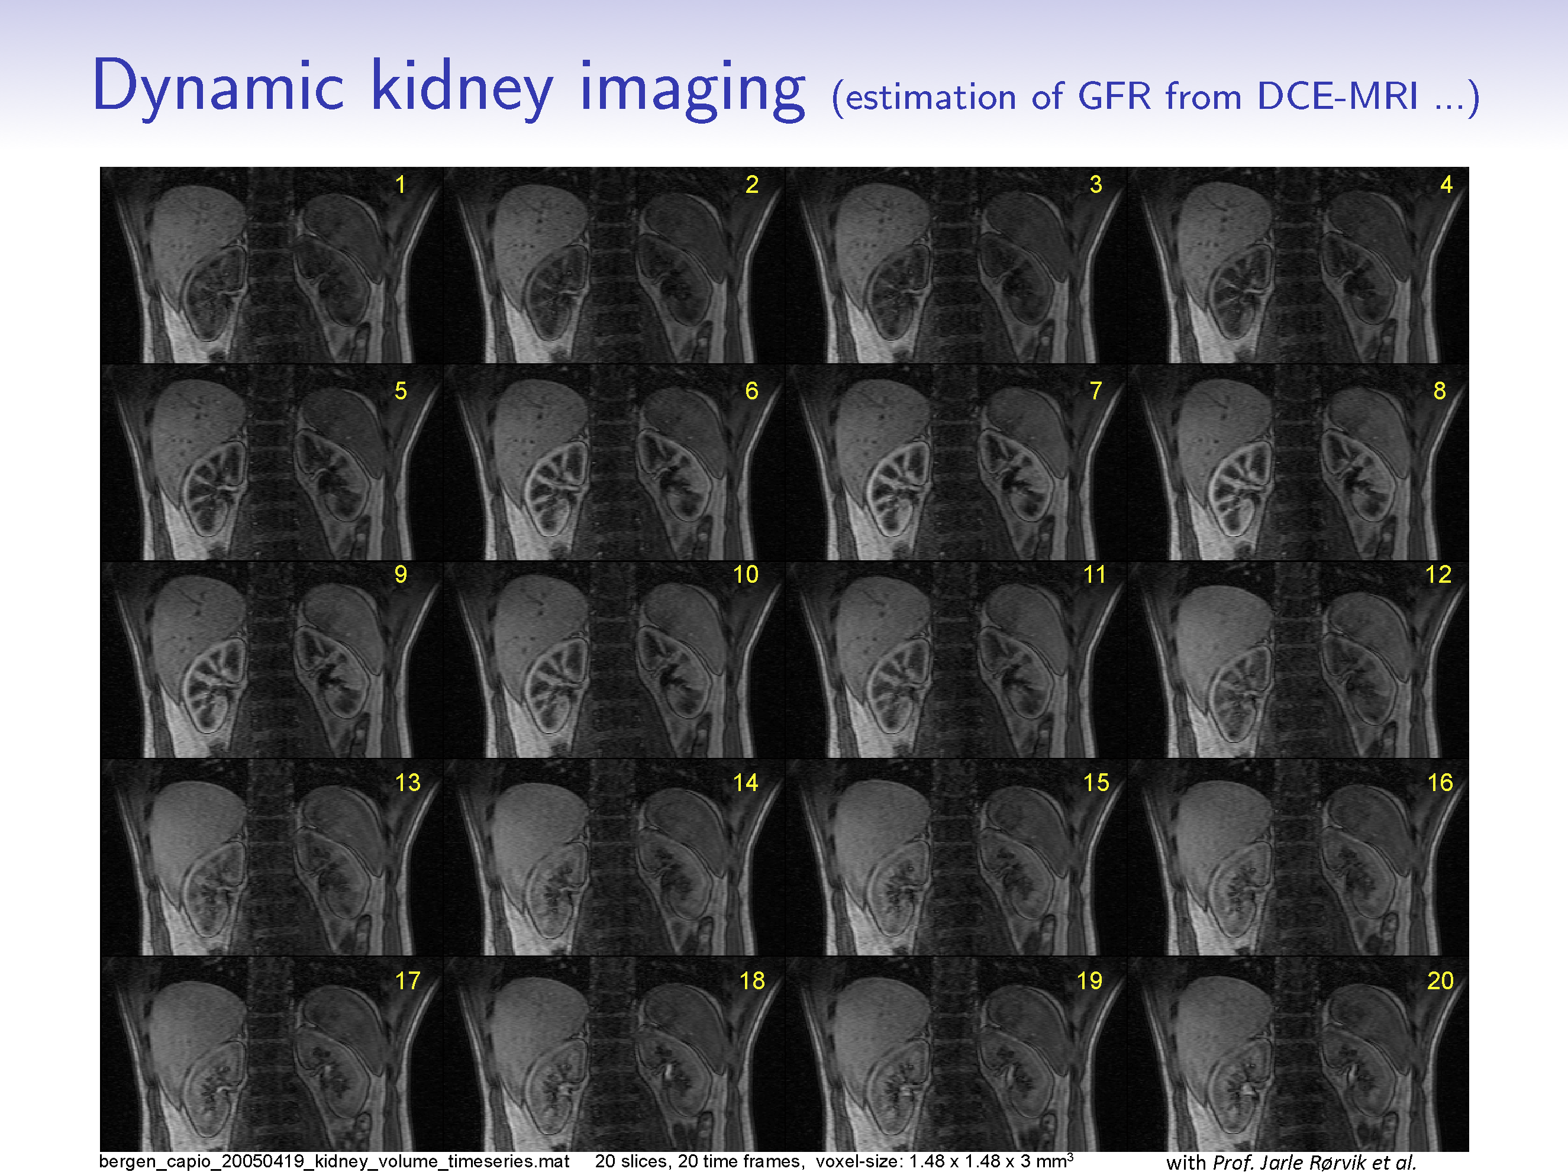
DCE-MRI of the moving kidney

Slide 17
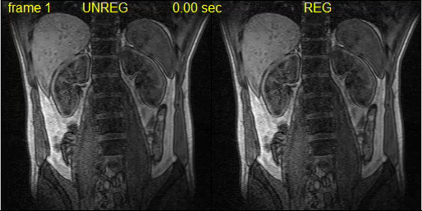
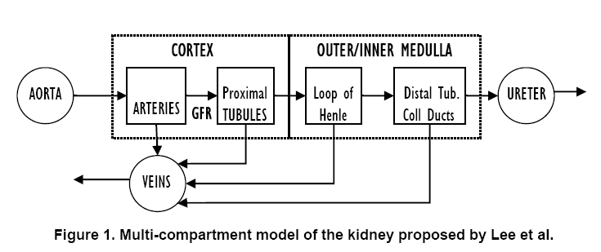
Pharmacokinetic modeling of perfusion and filtration using DCE-MRI
The
motion-
corrected
kidney
The
moving
kidney
R. Sance et al., ISPA 2006
Lee VS et al. Renal function measurements from MR renography and a simplified multicompartmental model. Am J Physiol Renal Physiol 2007;292:F1548–F1559.

Slide 18
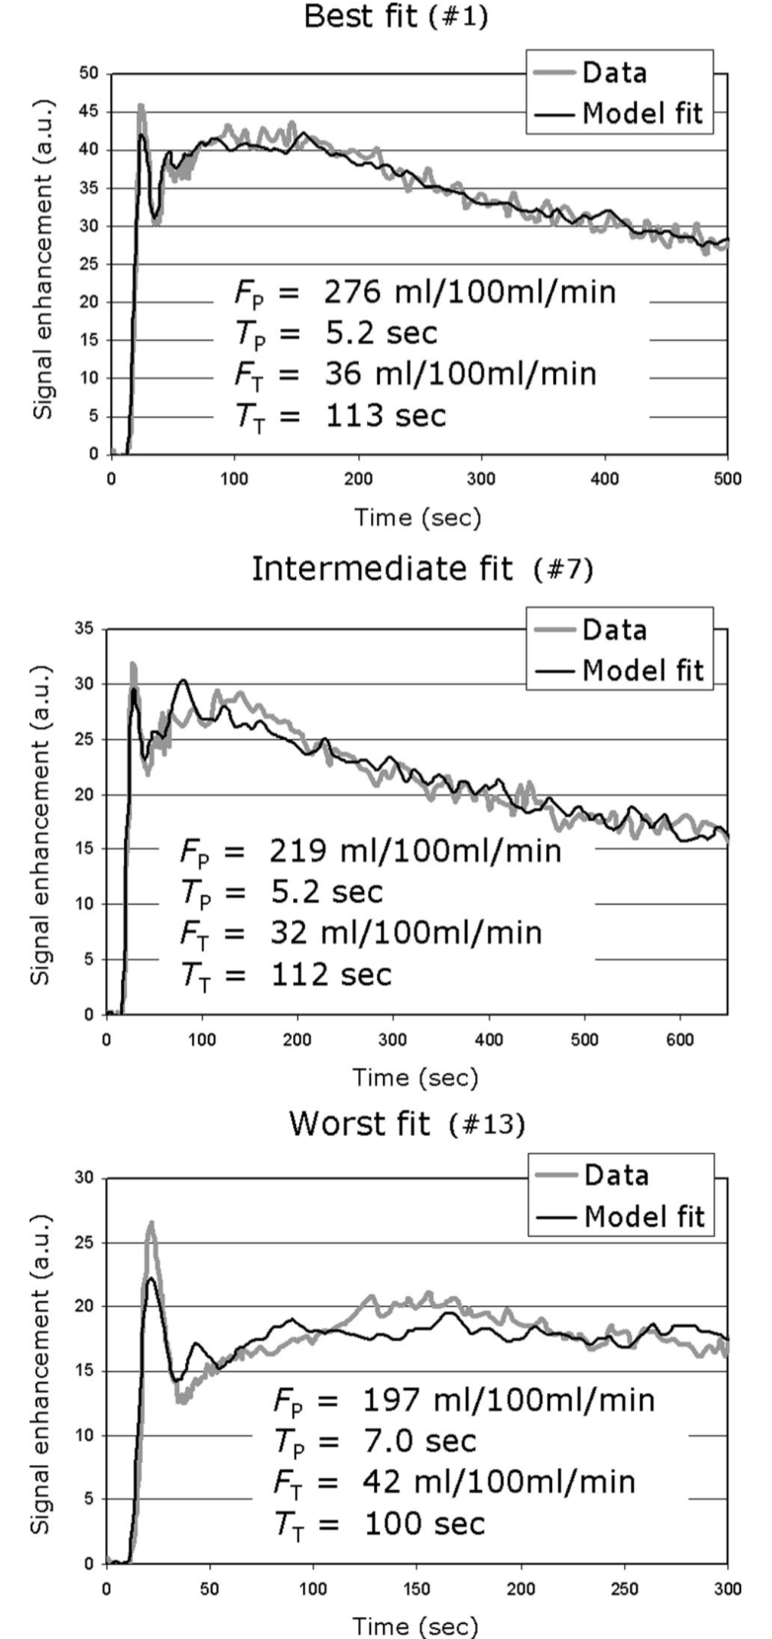
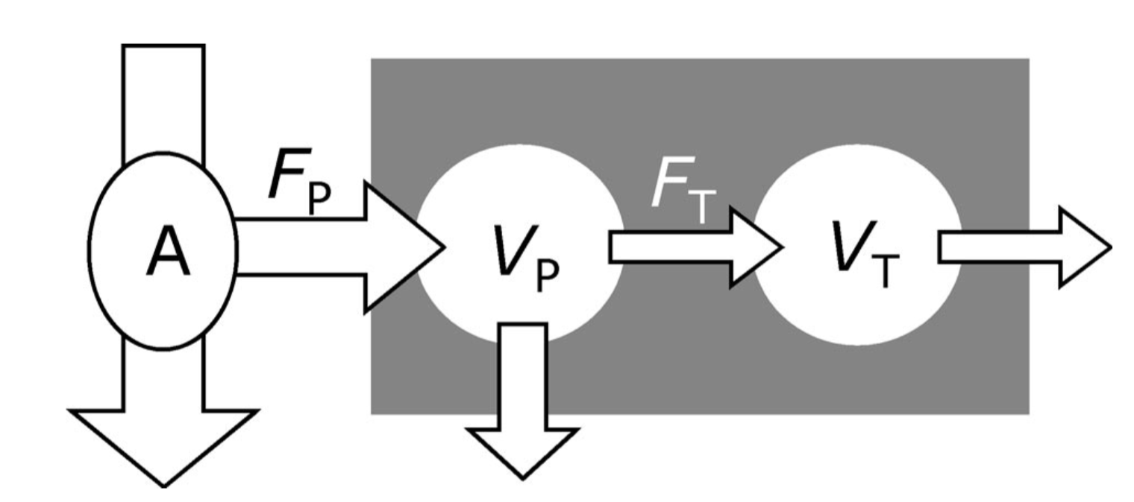
MRI-measurement of perfusion and glomerular filtration in
the human kidney with a separable compartment model
(Sourbron et al., 2008)
Feeding artery
Tissue voxel
Plasma
Tubuli
f (reabsorption fraction)
The plasma flow F_{P} carries the contrast agent from an
arterial region (A) into the tissue (gray rectangle)
It first enters the tissue plasma, where it distributes over
the plasma volume VP
A fraction of the entering contrast agent is filtered out of
the vascular space and is carried by the tubular flow F_{T} into
the tubular system where it distributes over the tubular volume VT
In the tubuli a fraction f of the filtrate is reabsorbed.
The contrast agent leaves the tissue carried by the outflow
out of the vascular and tubular spaces.
Sourbron et al. MRI-Measurement of Perfusion and Glomerular Filtration in the Human Kidney With a Separable Compartment Model. Investigative Radiology 2008;43:40-48.

Slide 19
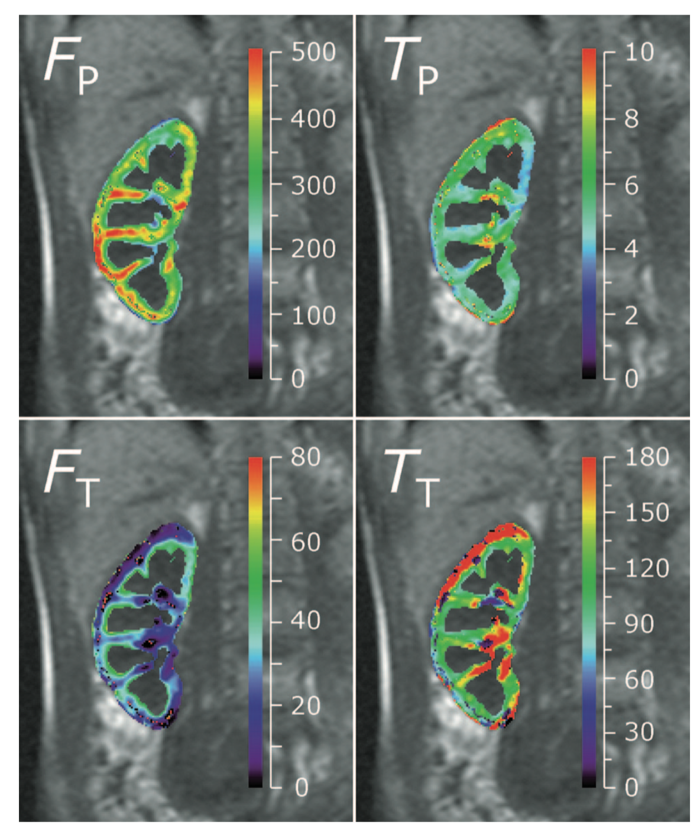
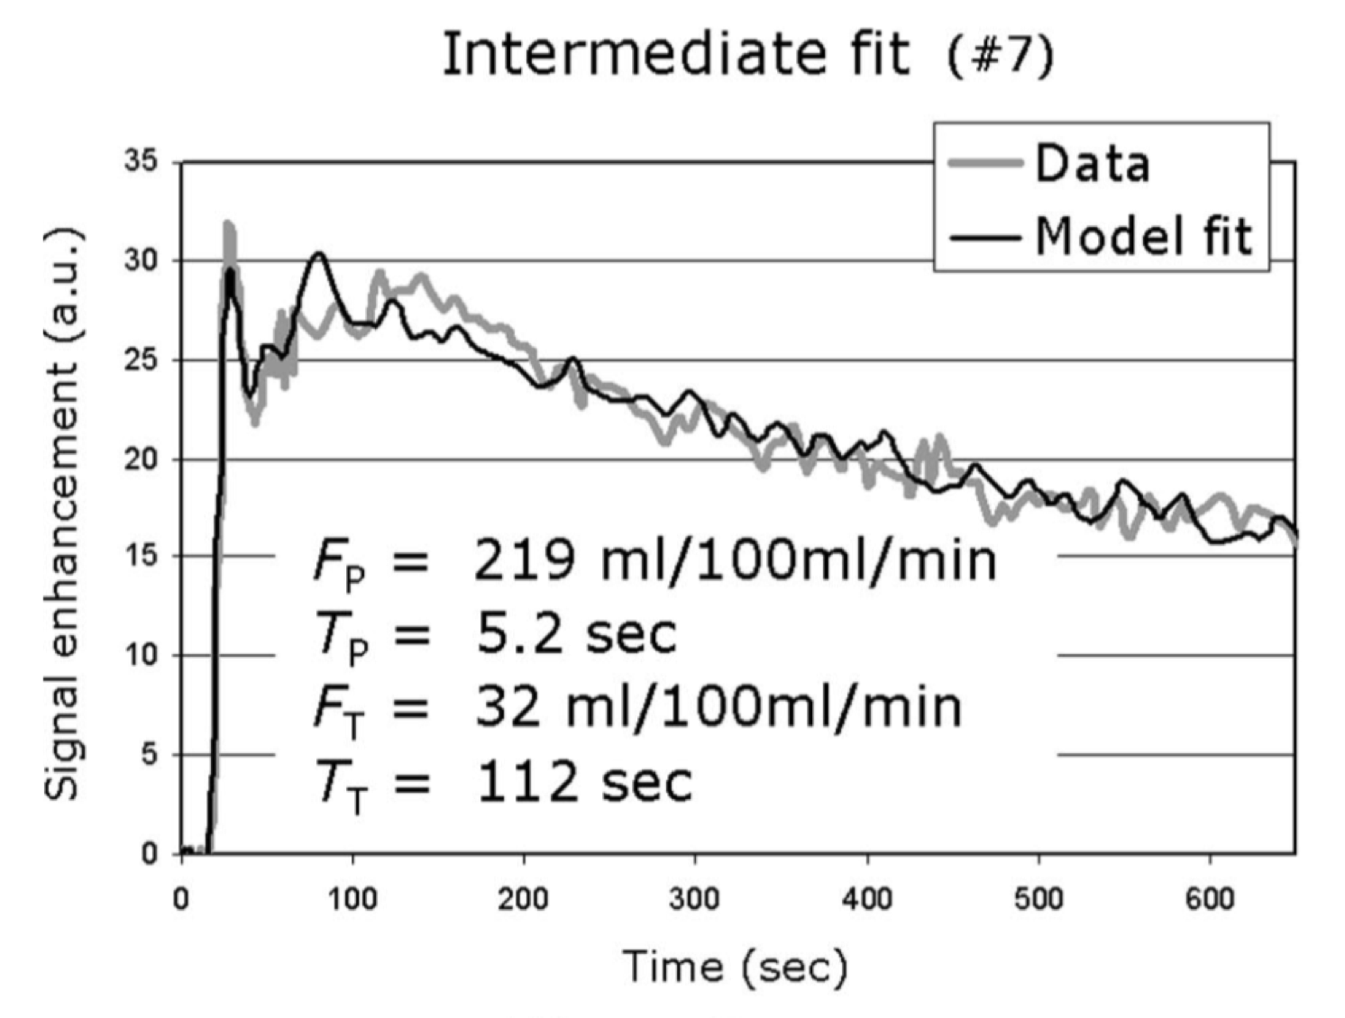
MRI-measurement of perfusion and glomerular filtration in
the human kidney with a separable compartment model
The four independent model parameters
F_{P} (mL/100 mL/Min)
T_{P} = MTT_{P} (sec)
F_{T} (mL/100 mL/ Min)
T_{T} = MTT_{T} (sec)
for the data with the intermediate fit accuracy
The cortex region was defined retrospectively as those pixels with V_{P} > 20 mL/100 mL.
The parametric maps (colored) are superposed on a precontrast image (gray) for anatomic reference.
Sourbron et al. MRI-Measurement of Perfusion and Glomerular Filtration in the Human Kidney With a Separable Compartment Model. Investigative Radiology 2008;43:40-48.

Slide 20




Renal compartment segmentation from DCE-MRI
(a) - (d) An exemplar slice of DCE-MRI series including both kidneys at four temporal points 1, 3, 7, and 23 respectively. For this patient, 1156 abdomen images are taken at 34 temporal points.
(e) By analyzing the enhancement of the renal tissues as a function of time, i.e. time intensity curves, one can determine clinically important single-kidney parameters such as the renal blood flow (RBF), glomerular filtration rate (GFR), and cortical and medullary blood volumes.
Mean signal intensity
Cortex
Medulla
Pelvis
Temporal measurements
DCE-MRI data
Preprocessing
MSTV-based Kidney
Segmentation
K-means clustering in segmented kidney
Results
t₀
t₀
Recognition
Segmented cortex
t_{n}
Medulla
Motion correction
Cortex
t_{n}
PCA Analysis on Entire Dataset
Segmented medulla
E(t) =
S(t) – S_{baseline}
S_{baseline}
Refinement
E(t) is relative
enhancement
Normalization
Principal Components
Segmented pelvis
MSTV = Maximally Stable Temporal Volume
Yang X et al. Renal compartment segmentation in DCE-MRI images. Medical Image Analysis 2016;32:269-280.

Slide 21

Fast semi-supervised segmentation of the kidneys in DCE-MRI using convolutional
neural networks (CNN) and transfer learning
POSTER P19
Alexander S. Lundervold et al.
~ 50 hr
without
motion-correction
Left & right kidney volumes
~ 5 hr
Mean SI time courses
WIP: aorta
segmentation
(AIF)
~ GFR, ~ RPF
~ 5 sec

Slide 22

What DCE-MRI can not tell us
van Eijs et al. (Utrecht) Innovative perspective: Gadolinium-free magnetic resonance imaging in long-term follow-up after kidney transplantation. Frontiers in Physiology 2017;8:296

Slide 23







What DCE-MRI can not tell us
A feedforward loop in the hypothesized processes
of the development of fibrosis in chronic kidney
disease, and their non-invasive modes of detection
BOLD
R₂* map. The scale denotes R₂* values in s⁻¹
a low R₂* indicates higher oxygenation
DWI
Tract density map
Renal tractography
Tract density map
T2-w anatomy
van Baalen et al. JMRI 2017
van Eijs et al. (Utrecht) Innovative perspective: Gadolinium-free magnetic resonance imaging in long-term follow-up after kidney transplantation. Frontiers in Physiology 2017;8:296

Slide 24



Multiparametric renal MRI
!
+ DCE-MRI filtration
DCE-MRI
Filtration
GFR, RPF
mL/100mL/min
Cox et al. (Nottingham) Multiparametric renal magnetic resonance imaging: validation, interventions, and alterations in chronic kidney disease. Frontiers in Physiology 2017;8:696

Slide 25
DCE-MRI: numerical analysis software
Interactive Data Language (IDL)
http://www.harrisgeospatial.com/ProductsandSolutions/GeospatialProducts/IDL.aspx
Sourbron S, Biffar A, Ingrisch M, Fierens Y, Luypaert R.
PMI: platform for research in medical imaging.
Magn Reson Mater Phy. 2009 Oct 1;22(1):539.
https://github.com/plaresmedima/PMI-0.4
PMI
https://sites.google.com/site/plaresmedima
OsiriX (C/C++) on MacOS
www.osirix-viewer.com
Zöllner FG, Daab M, Sourbron SP, Schad LR, Schoenberg SO, Weisser G.
An open source software for analysis of dynamic contrast enhanced magnetic resonance images: UMMPerfusion revisited.
BMC Med Imaging. 2016;16:7. doi:10.1186/s12880-016-0109-0.
http://ikrsrv1.medma.uni-heidelberg.de/redmine/projects/ummperfusion
UMMPerfusion
MATLAB
www.mathworks.com
Schmid VJ, Whitcher B, Padhani AR, Yang GZ.
Quantitative analysis of dynamic contrast-enhanced MR images based on Bayesian P-splines.
IEEE Trans Med Imaging. 2009;28(6):789-798. doi:10.1109/TMI.2008.2007326
https://github.com/petmri/ROCKETSHIP
ROCKETSHIP

Slide 26
DCE-MRI: numerical analysis software
The R language
www.r-project.org
Schmid VJ, Whitcher B, Padhani AR, Taylor NJ, Yang GZ.
Bayesian methods for pharmacokinetic models in
dynamic contrast-enhanced magnetic resonance imaging.
IEEE Transactions on Medical Imaging 2006;25(2):1627-1636.
http://dcemri.sourceforge.net https://cran.r-project.org/web/packages/dcemriS4
dcemriS4
The R language
Ferl GZ.
DATforDCEMRI: An R Package for Deconvolution Analysis
and Visualization of DCE-MRI Data
Journal of Statistical Software 2011;44(3):1-18.
https://cran.r-project.org/web/packages/DATforDCEMRI
www.r-project.org
DATforDCEMRI
The Julia language
http://julialang.org
Smith DS, Li X, Arlinghaus LR, Yankeelov TE, Welch EB.
DCEMRI.jl: a fast, validated, open source toolkit for dynamic
contrast enhanced MRI analysis.
PeerJ. 2015;3:e909. doi:10.7717/peerj.909
https://github.com/davidssmith/DCEMRI.jl https://www.ncbi.nlm.nih.gov/pubmed/25922795
DCEMRI.jl
The Python language
Python module :
https://github.com/welcheb/pydcemri
www.python.org

Slide 27
Thanks !

